Slide 1



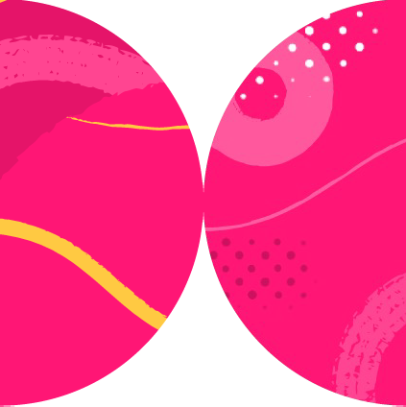

Training Your Own Chatbot
Xavier Morera
Helping developers create epic applications
www.xaviermorera.com / www.bigdatainc.org / www.lupo.ai

Slide 2
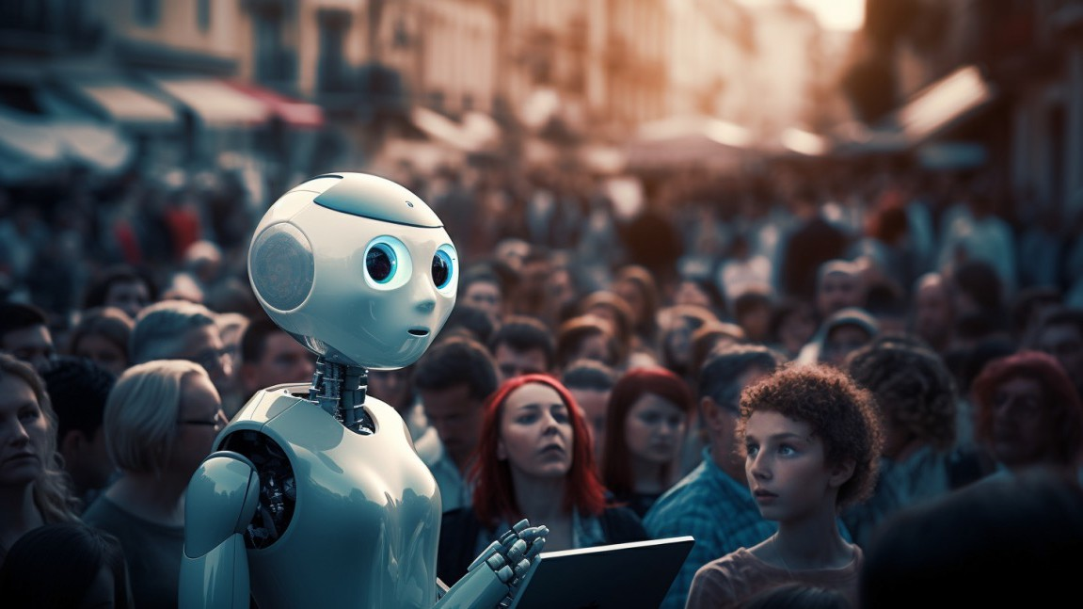
Good chatbots are hard to find
[live-video]

Slide 3

Chatbots: Usage and Importance

Slide 4
Benefits Offered by Chatbots
Data collection
Consistency
Customer service 24/7
Multilingual support
Continuous learning
Scalability
Instant responses
Cost savings

Slide 5


Chatbots are not the answer to everything; there are some limitations
Chatbots can't entirely replace humans.
Especially for complex or sensitive issues. Humans still make a difference.

Slide 6
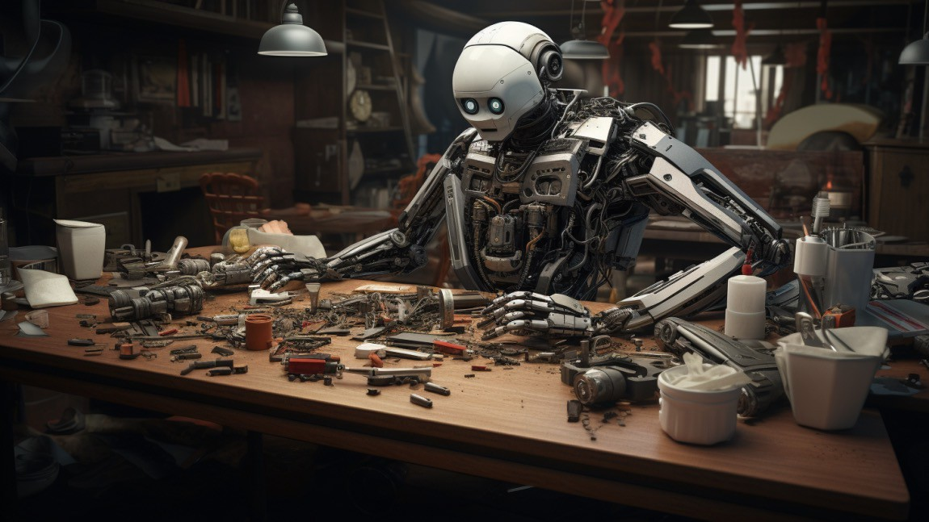
Let me show you how to build a chatbot

Slide 7
Building a ChatBot

Slide 8
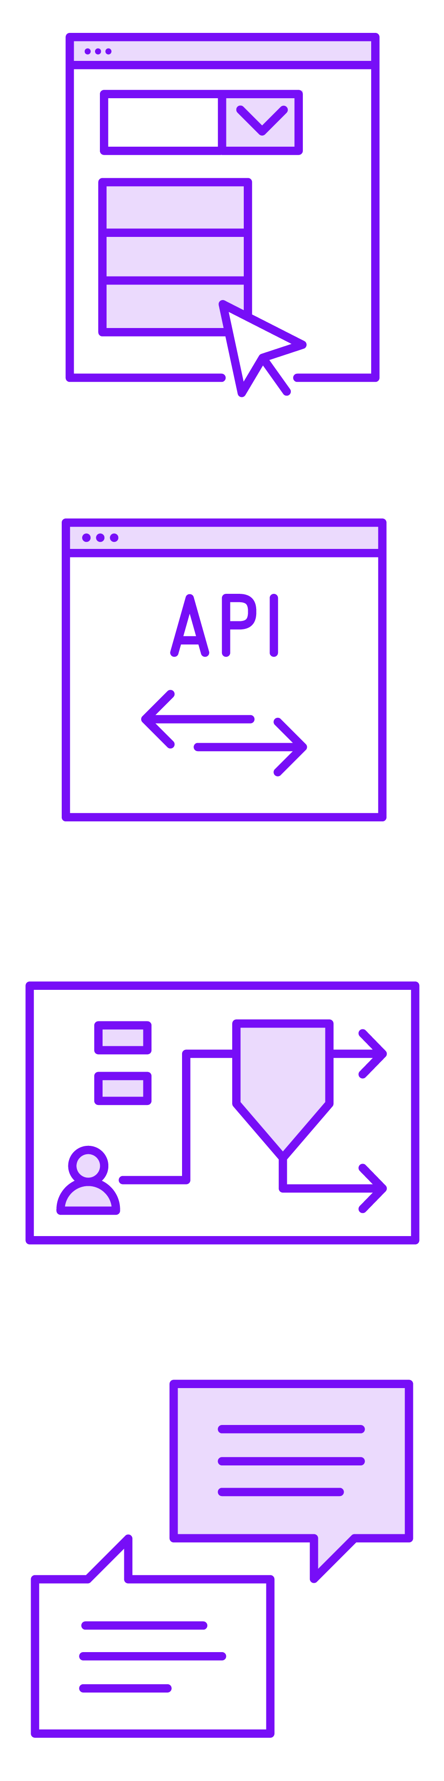

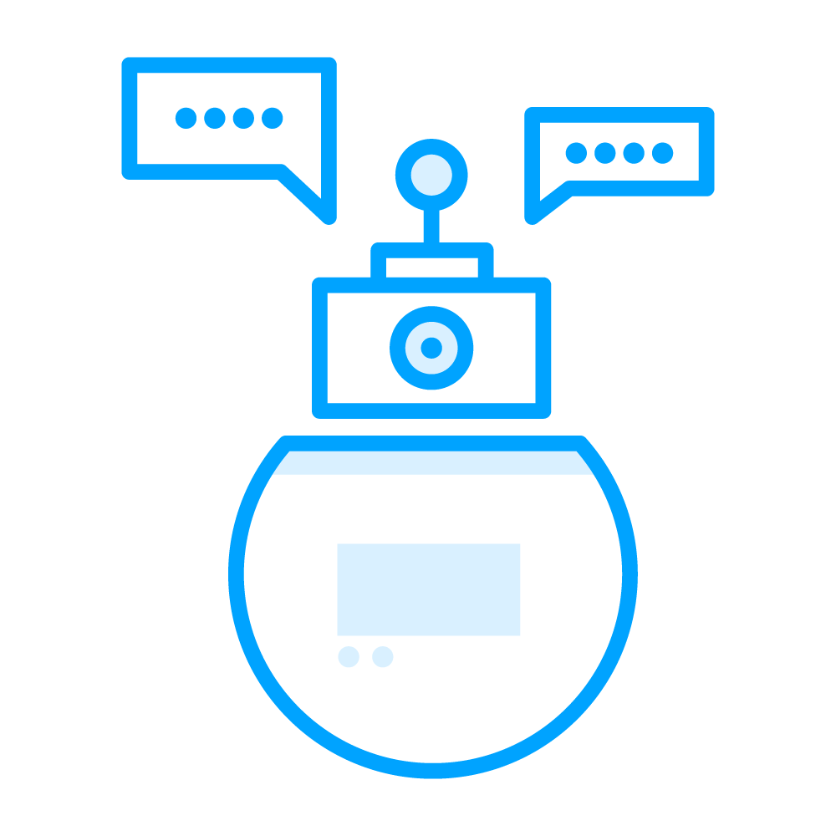

Building a Chatbot

Slide 9

Building a chatbot

Slide 10
Fine Tuning

Slide 11
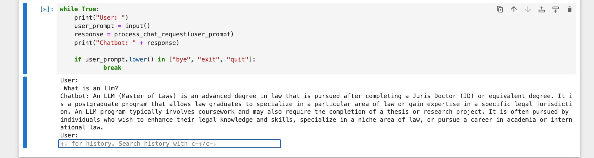
Not a One Size Fits All Solution
User: What is an LLM?
Chatbot: An LLM (Master of Laws) is an advanced degree in law...

Slide 12

Fine tuning

Slide 13


Fine Tuning
Process of taking a pre-trained model
For example, the base GPT model
Further training it on a specific dataset
Typically a smaller dataset
Specialize or adapt to a particular task or specific domain

Slide 14
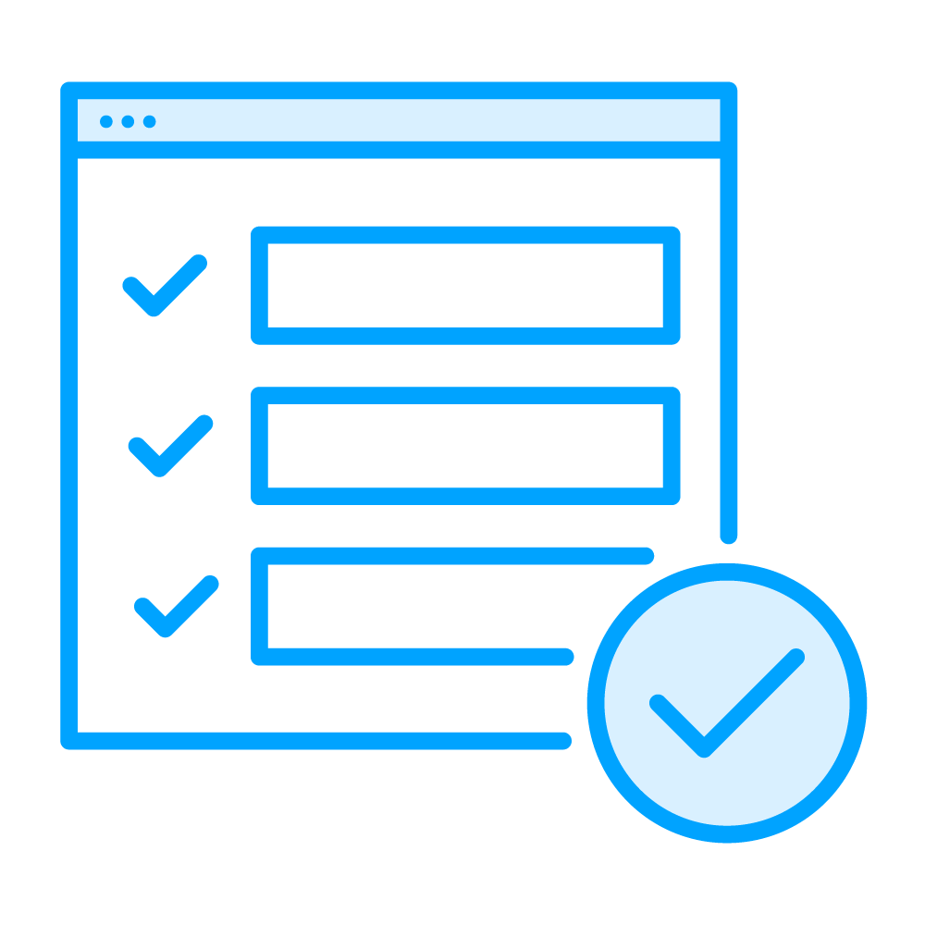
Advantages of Fine Tuning
Higher quality results
Even better than prompt design
Ability to train on more examples than can be fit into a prompt
It is better than using few-shot learning
Shorter prompts
Less tokens used

Slide 15

Benefits of Fine Tuning
Safety and reliability
Specialization
Customization

Slide 16
What is the Difference?
Chatbot
Conversational agent Simulates conversation
Fine tuning
Technique used to adapt a pre- trained model
To a specific dataset For specialized interactions

Slide 17
Fine Tuning Models

Slide 18
Fine tuning models

